Slide 1
Dashboard and buttons
Utkarsh Gaikwad
Class starting at 6:06 pm

Slide 2
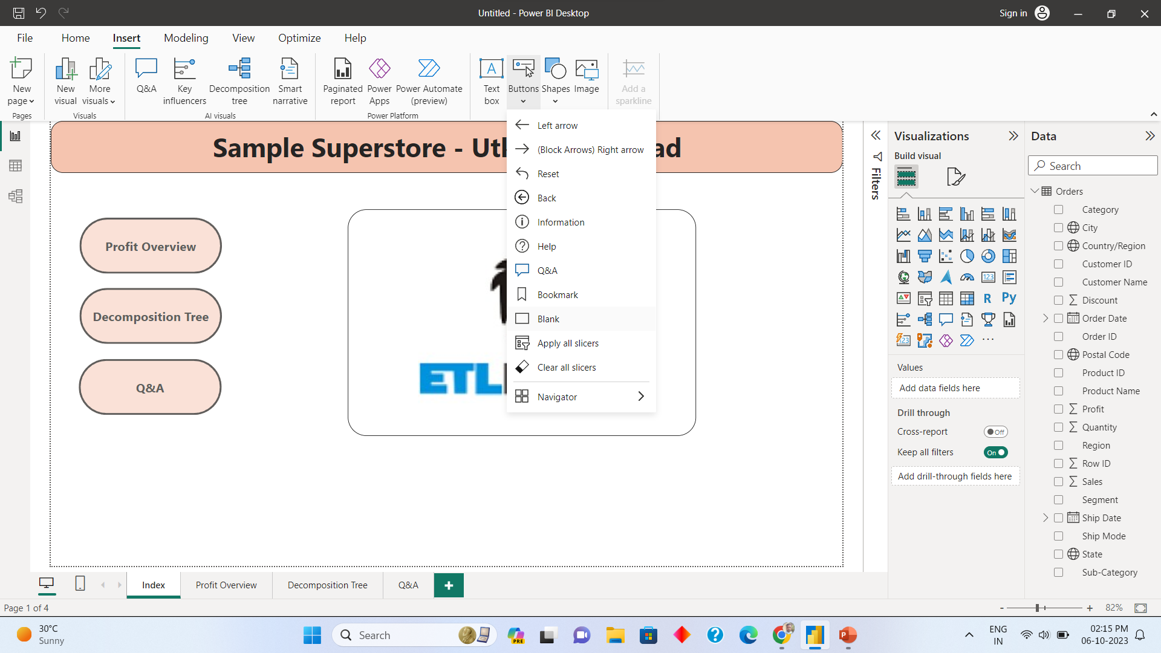
Insert Button

Slide 3
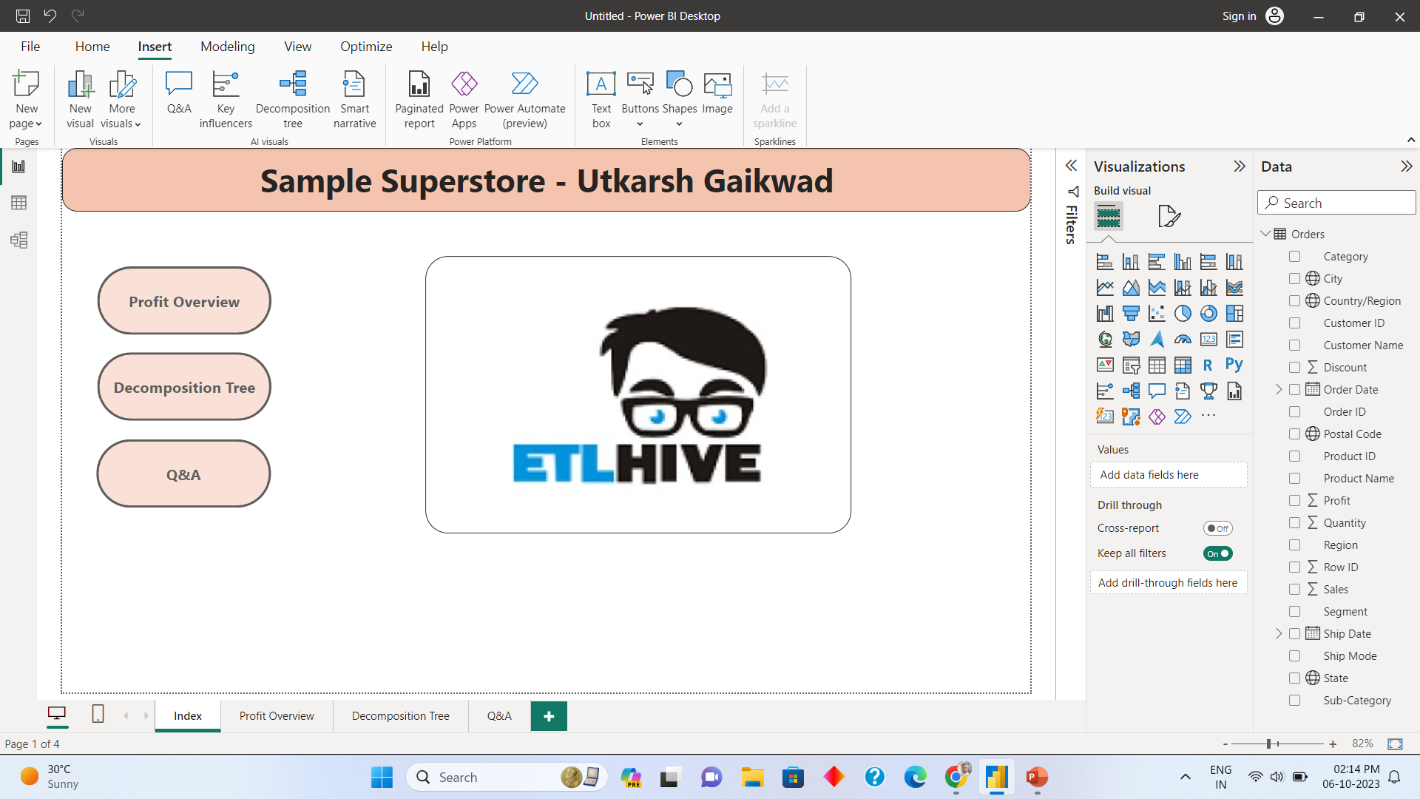
Index Page

Slide 4
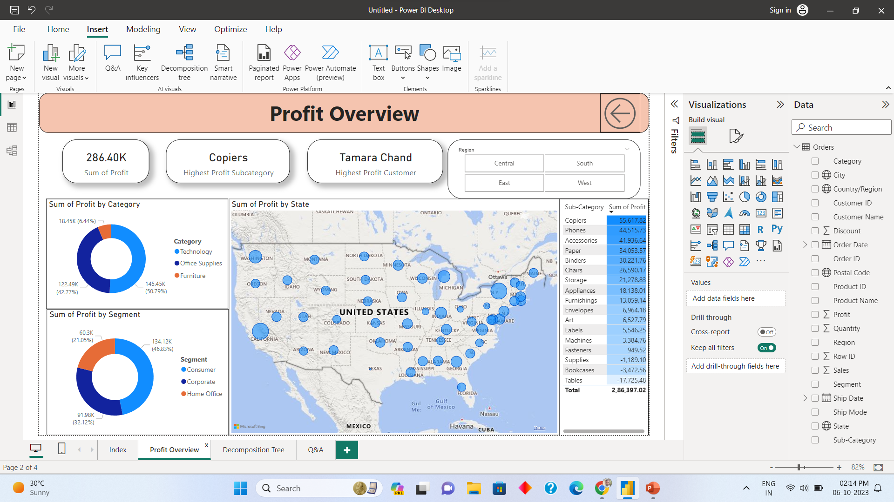
Profit Overview

Slide 5
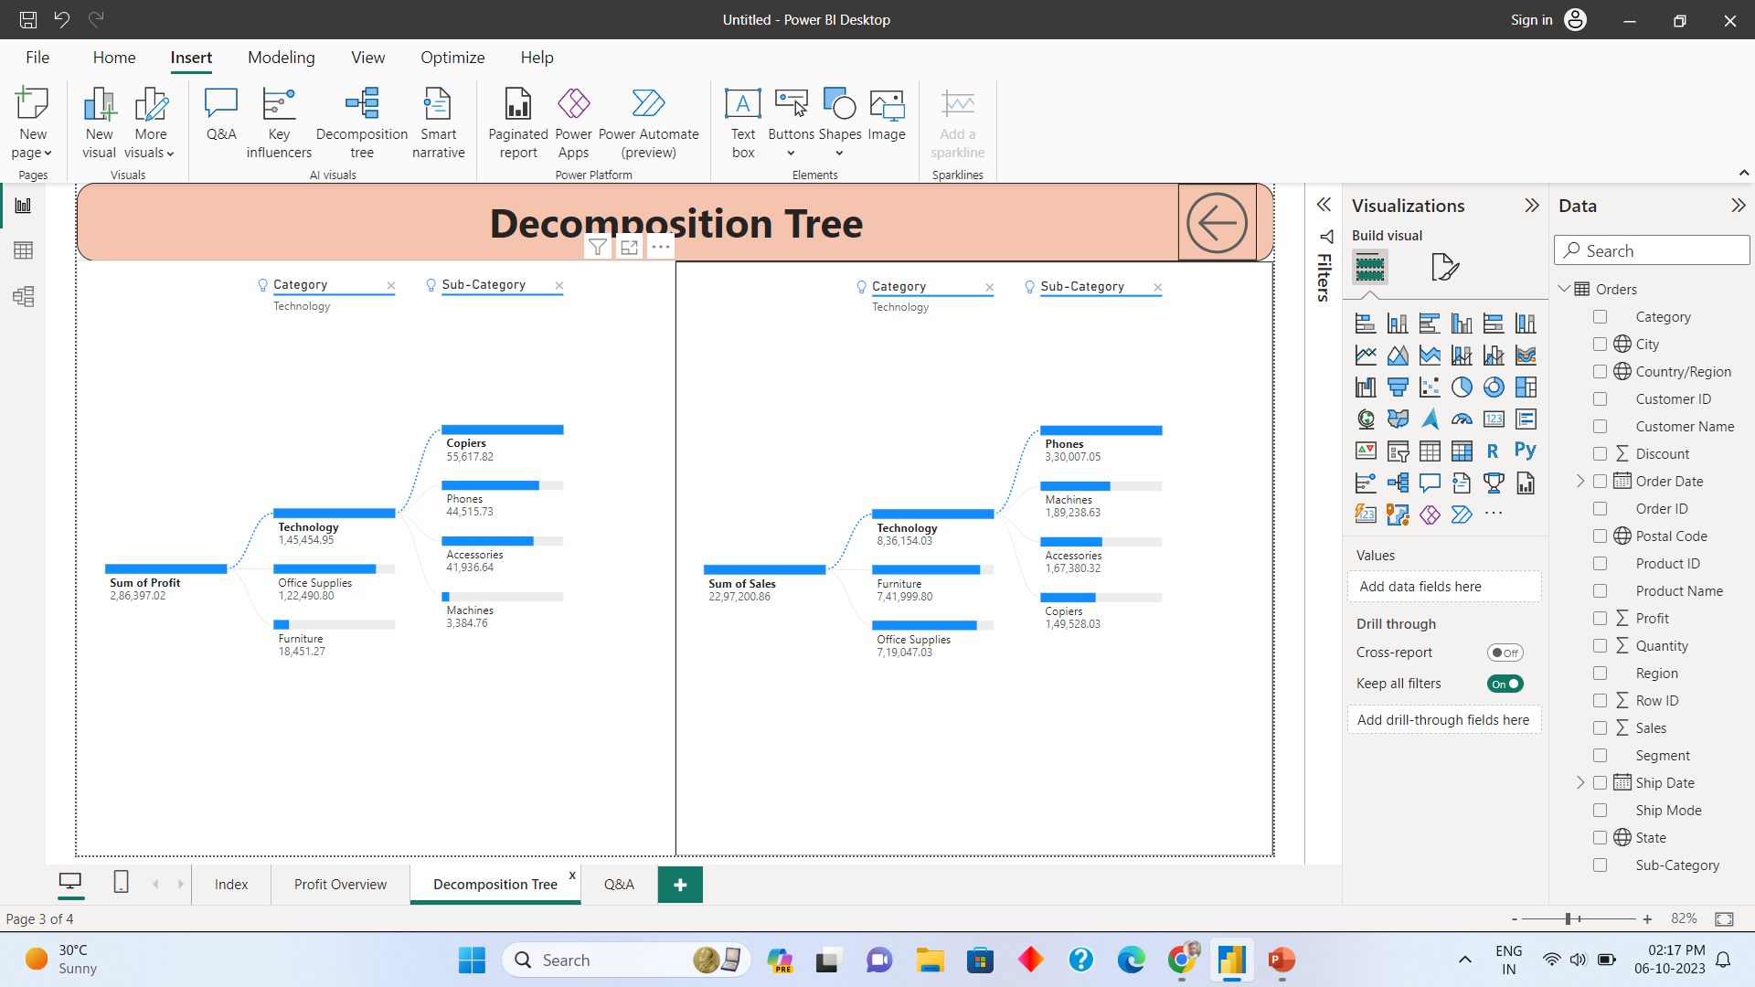
Decomposition Tree

Slide 6
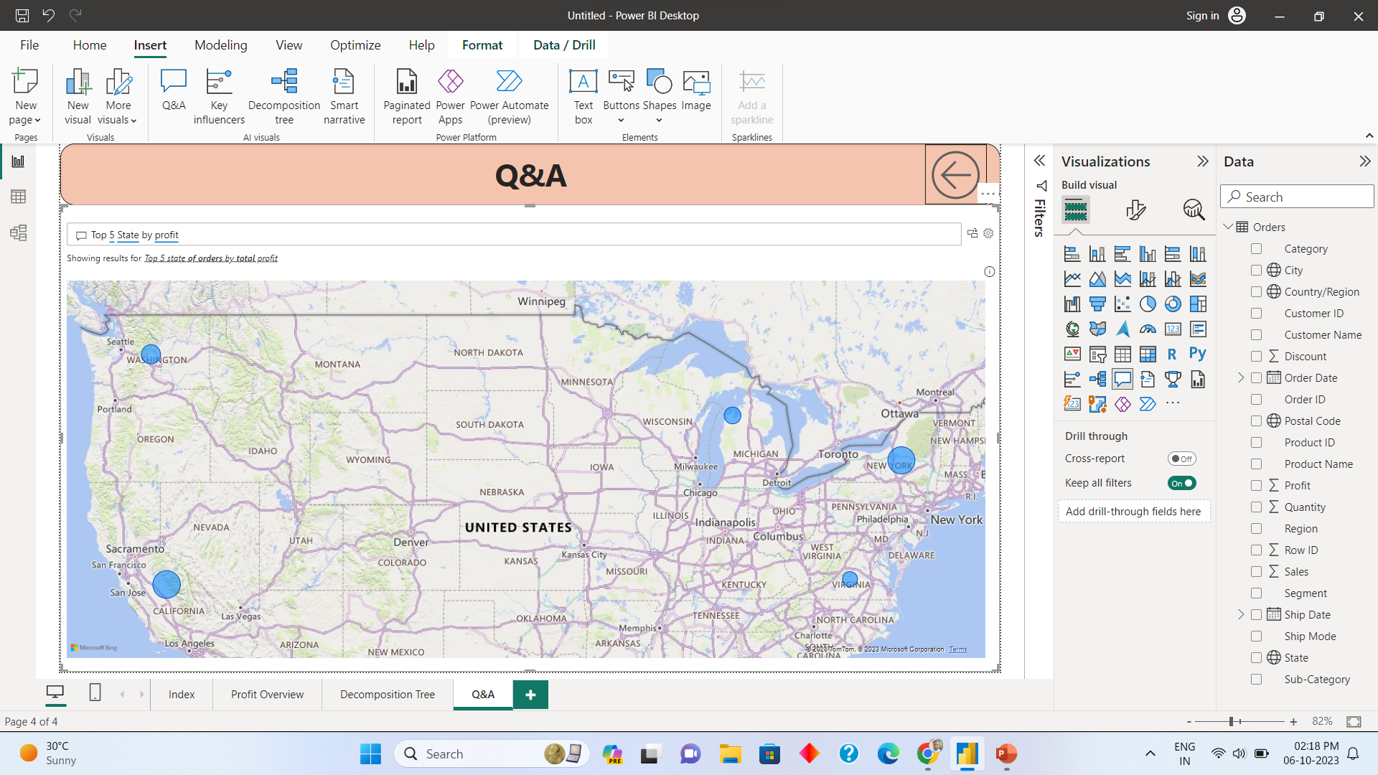
Q&A

Slide 7
Thank you
Utkarsh gaikwad

